Slide 1
JavaScript and JSON
Trainer: Tuan Nguyen
Professional Software Engineer

Slide 2
Introduction
Your name
Your background and experience in the subject
HTML, CSS
What do you want from this course

Slide 3
Objectives
At the end of the course, you will have acquired sufficient knowledge to:
Understand the core of JavaScript and JSON
Build or modify dynamic web pages and web applications.

Slide 4

Prerequisite
Have knowledge
Html(5), Css(3)
Editor:
VS, Eclipse, Notepad++, Brackets, Sublime Text …
Developer tool:
Firebug (Firefox), Chrome developer tool…

Slide 5
Assessment Disciplines & Timetable
Assessment Disciplines
Class Participation : Required
Assignment Completion : 100%
Pass Criteria: >=70%
Course Timetable
Lecture Duration: 6 hours

Slide 6
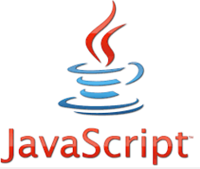

Agenda
JavaScript Overview
JavaScript grammar and Types
JavaScript Functions
JavaScript Prototypes
Document Object Model
Browser Object Model
AJAX
JSON
Notes:
https://www.quackit.com/javascript/examples/

Slide 7
JavaScript Overview

Slide 8







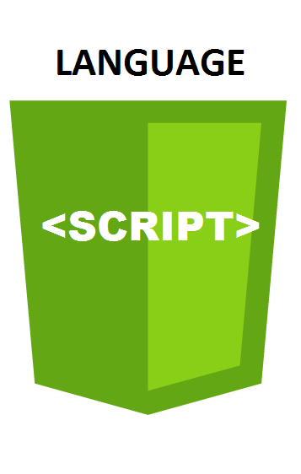

Client-Server in Web
Request
HTTP(S)
Response
. . .
…
JavaScript
ECMA Script
DOM
BOM

Slide 9
JavaScript History
Created by NetScape
The general-purpose core of the language has been embedded in NetScape, Chorme, Firefox, Internet Explorer, and other web browsers

Slide 10
What is JavaScript?
JavaScript is the programming language
JavaScript is free
NOT JAVA .

Slide 11
Why Study JavaScript?
JavaScript is one of the 3 languages all web developers must learn:
1. HTML to define the content of web pages
2. CSS to specify the layout of web pages
3. JavaScript to program the behavior of web pages
Web pages are not the only place where JavaScript is used. Many desktop and server programs use JavaScript. Node.js is the best known. Some databases, like MongoDB and CouchDB, also use JavaScript as their programming language.

Slide 12
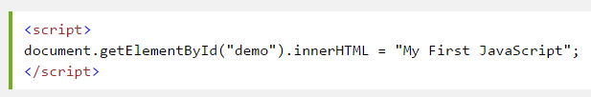
Location of JS in html
JavaScript is put inside HTML between <script>
<script> tag could be put in any places inside a html page (at <head>, <body> or after the </body> close tag) depending on when you want the JavaScript to load.
Can be kept in an external JavaScript file and referenced in HTML code

Slide 13
Location of JS (example)
<!DOCTYPE HTML PUBLIC "-//W3C//DTD HTML 4.01 Transitional//EN"
"http://www.w3.org/TR/html4/loose.dtd">
<html>
<head>
<title>JavaScript Location Example</title>
<script type="text/javascript“ src=“js/script.js”></script>
<script type="text/javascript">
alert(“This is inline JavaScript in <head> tag.");
</script>
</head>
<body>
<script type="text/javascript">
alert(“This is inline JavaScript in <body> tag.");
</script>
<h1>This is a JavaScript Location Example</h1>
</body>
</html>
/js/script.js
alert("This is external JavaScript");

Slide 14
JavaScript Variable and Data Types

Slide 15
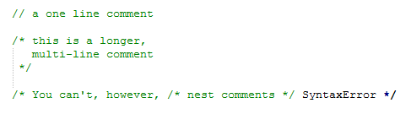
Comments
The syntax of comments is the same as in C++ and in many other languages

Slide 16
Variable Declarations
There are three kinds of declarations in JavaScript.
var
Declares a variable, optionally initializing it to a value.
Can be used to declare both local and global variables.
let
Declares a block-scoped local variable, optionally initializing it to a value.
const
Declares a block-scoped, read-only named constant.
Notes:
Without var?
Local variable
Can only be accessible from inside a function where it is defined.
Is hidden from other functions and other scripting code.
Global variable
Can be accessible and changed from everywhere in the page.
Belongs to the window object in the web page.

Slide 17
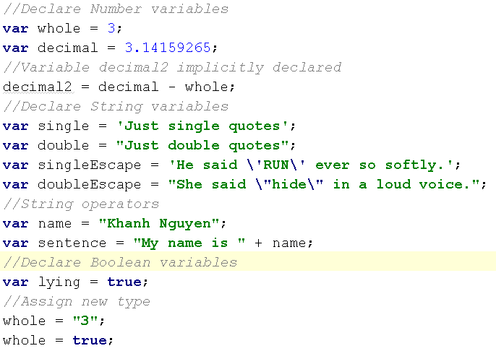
Variables Naming Convention
Can begin with a letter or $, _
Data type declaration is not needed in JS
Be aware that $ and _ prefix variables should be reserved for system and libraries

Slide 18
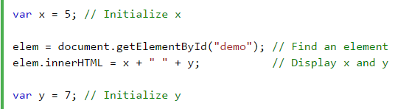
Variables Hoisting
A variable can be used before it has been declared
Hoisting (JS behavior) moves all declarations to the top of current scope.
In ECMAScript 2015, let (const) will not hoist the variable to the top of the block. However, referencing the variable in the block before the variable declaration results in a ReferenceError.
Notes:
ES là một tập hợp kỹ thuật nâng cao của javascript và nó là 1 chuẩn mực để làm theo.

Slide 19
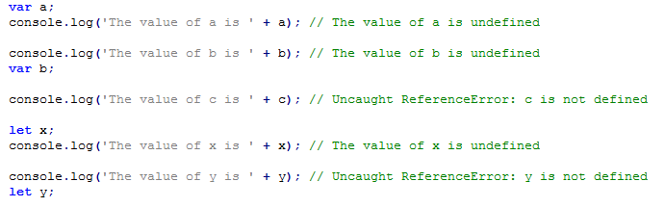
Variables Hoisting

Slide 20
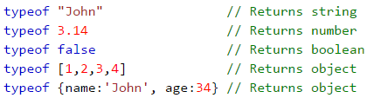
Data types
Boolean
null
undefined a top-level property whose value is undefined.
Number
String
Symbol (new in ECMAScript 2015)
Object
Notes:
Because JavaScript is case-sensitive, null is not the same as Null, NULL, or any other variant.
person = undefined; // Value is undefined, type is undefined
var person = null; // Value is null, but type is still an object
How can you check for array when it returns typeof as object?

Slide 21
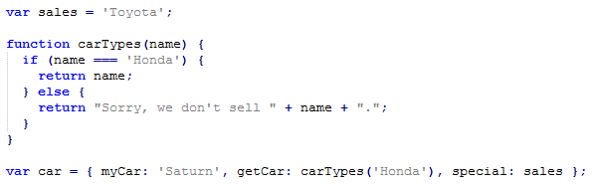
What is an object
Can be thought of as collections of key and value pairs
Where the value part can contain properties or methods
Object literal syntax:
{ name1 : value1 , ... , nameN : valueN }
Notes:
var x = new String(); // Declares x as a String object var y = new Number(); // Declares y as a Number object var z = new Boolean(); // Declares z as a Boolean object
RegExp literals
A regex literal is a pattern enclosed between slashes. The following is an example of an regex literal.
var re = /ab+c/;

Slide 22
Other ways to create object
Use new to create blank object, then add fields to it later
var course = new Object(); course.number = "CIT597"; course.teacher = "Dr. Dave";
Use a constructor
function Course(n, t) { this.number = n; this.teacher = t; }
var course = new Course("CIT597", "Dr. Dave");

Slide 23

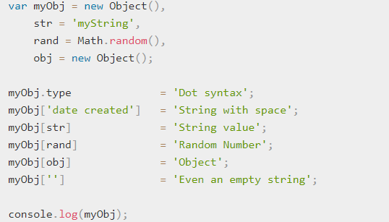
Objects and properties
A JavaScript object has properties associated with it:
Properties types:
Notes:
var myObj = new Object(), str = 'myString', rand = Math.random(), obj = new Object(); myObj.type = 'Dot syntax'; myObj['date created'] = 'String with space'; myObj[str] = 'String value'; myObj[rand] = 'Random Number'; myObj[obj] = 'Object'; myObj[''] = 'Even an empty string'; console.log(myObj);

Slide 24
Objects and properties
Enumerate the properties (loop):
Delete properties:
Use for in for objects
With array, use normal for loop
Don’t use for in with array
var obj = {a: 1, b: 2, c: 3};
for (var key in obj) {
console.log(obj[key]);
}
var obj = {a: 1, b: 2, c: 3};
delete obj.a;
for (var key in obj) {
console.log(obj[key]);
}
Notes:
For in used for array or object. (for index in array) or (for key in object)
Vs
For of used for iterable such as array. (for instance of myArray)

Slide 25
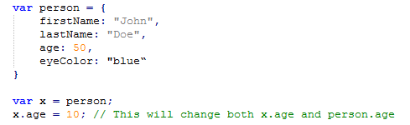
Objects are Mutable
Objects are mutable: They are addressed by reference, not by value:

Slide 26
Array
No variable type declaration
Array literal syntax:
[ value1, ... , valueN ]
Arrays index counted from zero.
var coffees = ['French Roast', 'Colombian', 'Kona'];
var fish = ['Lion', , 'Angel'];
var myList = ['home', , 'school', ];

Slide 27
Other ways to create array
Use new Array() to create empty array
var color = new Array();
color[0] = “red”;
Use new Array(n) with numeric argument to create empty array with that size
var color = new Array(3);
Use new Array(…) with initial values
var color = new Array(“red”, “blue”, “green”);

Slide 28
Array functions
Loop:
fruits.forEach(function(item, index, array) {
console.log(item, index);
});
Find the index of an item in the Array
fruits.push('Mango’);
// ["Strawberry", "Banana", "Mango"]
var pos = fruits.indexOf('Banana’);
// 1
Notes:
https://developer.mozilla.org/en-US/docs/Web/JavaScript/Reference/Global_Objects/Array
How do you remove an element from array? Delete vs splice

Slide 29
Array functions
Functions | Description
sort() | Sort the array alphabetically
reverse() | Reverse the array elements
push(object) | Add any number of new elements to the end of the array, and increase the array’s length
pop() | Remove and return the last element of the array, and decrease the array’s length
toString() | Return a string containing the values of the array elements, separated by commas.

Slide 30
Array functions sort() numerical and reverse
https://www.w3schools.com/js/js_array_sort.asp

Slide 31
Array functions splice() merge() slice()
https://www.w3schools.com/js/js_array_methods.asp

Slide 32
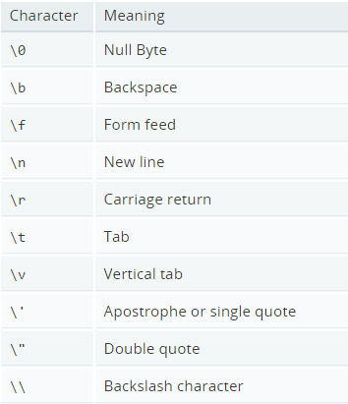
JavaScript special characters

Slide 33
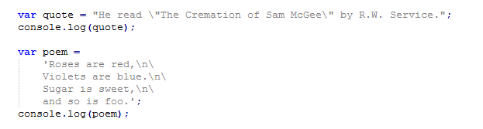
JavaScript special characters

Slide 34
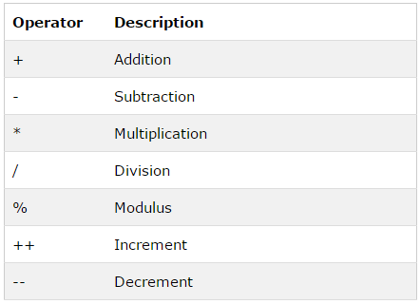
Operators
Arithmetic Operators

Slide 35
Operators
Arithmetic Operators +
Can be used for addition or string concatenation
If two operands are number, + will be addition
If one of them are not number, + will be concatenation

Slide 36
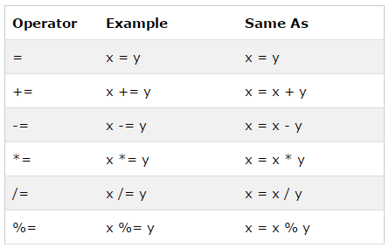
Operators (cont)
Assignment Operators
var x = "5" + 2 + 3;
var x = 2 + 3 + "5" ;
var x = 2 - 3 - "5" ;
var x = "5" - 2 - 3;
Notes:
If you add a number to a string, the number will be treated as string, and concatenated.

Slide 37
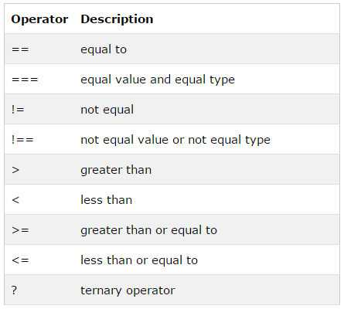
Operators (cont)
Comparison Operators
Notes:
var var1 = 3;
3 == var1;
3 === var1;
var1 !== "3“;

Slide 38
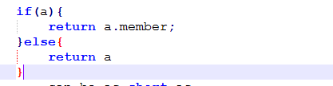
Operators Logical
&&
It can also be used for checking null and undefined

Slide 39
Operators Logical
||
It can also be used for setting default value

Slide 40
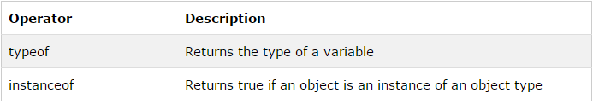
Operators (cont)
Type Operators
Note: objectType is an object type
Special cases: such as Date or Array. Must use instanceof cannot use typeof
typeof operand;
typeof (operand);
objectName instanceof objectType;

Slide 41
Conditionals
var a = 5; var b = 7;
console.log(a > b ? a : b)
if... statement
if...else statement
if...else if....else statement
if (condition1) {
conditional 1 code execute;
} else if (condition2){
conditional 2 code execute;
} else {
conditional 3 code execute if 2 above not match;
}

Slide 42
Conditionals (cont)
switch statement
switch (n)
{
case 1:
conditional 1 code execute;
break;
case 2:
conditional 1 code execute;
break;
default:
code execute if n is different from 1 and 2;
}

Slide 43
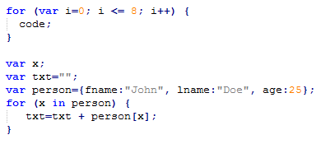
Loops
for and for…in loop

Slide 44
Loops (cont)
while and do… while loop
while (i < 8) {
code to be executed;
}
do {
code to be executed;
} while (i < 8)

Slide 45
Error handling
The try...catch… statement
The try block contains the code to be run, and the catch block contains the code to be executed if an error occurs.
try {
// code to be executed and can be generated errors;
} catch (err) {
// Handle errors here
}

Slide 46
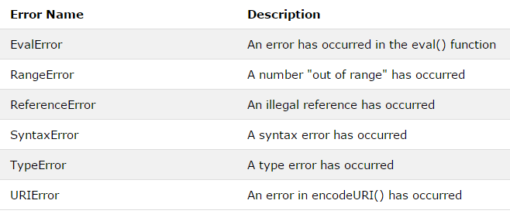
Error handling

Slide 47
JavaScript Functions

Slide 48
Functions
In JavaScript, functions are first-class objects, which means they can be:
stored in a variable, object, or array.
passed as an argument to a function.
returned from a function.
Basically, first-class citizenship simply means “being able to do what everyone else can do.”
function boo(what) {
return what;
}
or
var boo = function(what) {
return what;
};

Slide 49
Functions
A function will be executed by an event or by a call to the function.
A function can be declared nested with child function inside.
function function_name(var1, var2,…, varN) {
// code to be executed inside function;
}
function function_name(var1, var2,…, varN) {
// code to be executed inside function;
function sub_function_name(…) {
// code to be executed inside function;
}
}

Slide 50
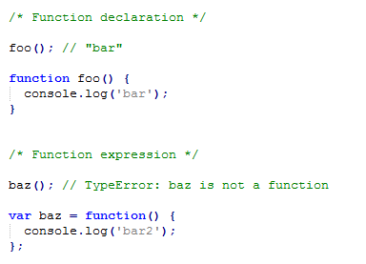
Function Hoisting
A function can be used before it is declared
Hoisting (JS behavior) moves all declarations to the top of current scope.

Slide 51
function as variable
When invoked with new keyword, function returns an object known as this.
We can modify properties and methods of this before it’s returned.
var Person = function(name) {
this.name = name;
this.say = function() {
return "Je m'appelle " + this.name;
};
};

Slide 52
function as variable
An object created with Constructor.
var julien = new Person("Julien");
julien.say();
→ "Je m'appelle Julien"
Notes:
constructor property

Slide 53
Constructor
Use this | Not that
var o = {}; | var o = new Object();
var a = []; | var a = new Array();
var re = /[a-z]/gmi; | var re = new RegExp('[a-z]', 'gmi');
var fn = function(a, b){ return a + b; } | var fn = new Function('a, b', 'return a+b');

Slide 54
What is “this”?
“this” is a special keyword in JS,
To determine what is the correct object “this” refers to, we need to look at how the function invoked
When function invoked with new
When function invoked with call or apply or bind
When function invoked within a context object
When function invoked normally (default behavior)

Slide 55
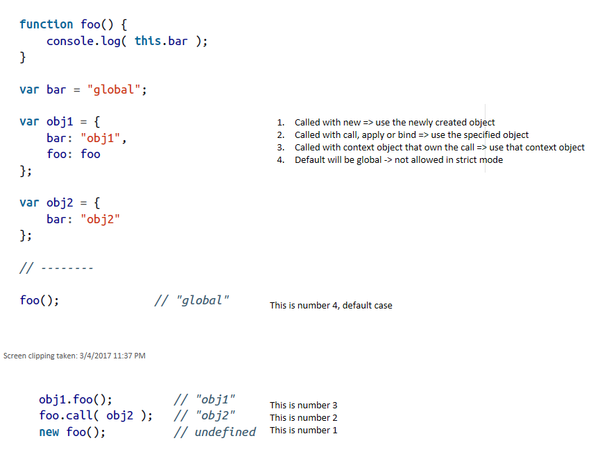
What is “this”?

Slide 56
JavaScript Prototype

Slide 57
Prototype
Every JavaScript object has a prototype that can be access via __proto__
Prototype is also an object, which can be consider as parent object
When we defined function, the prototype can be accessed via property “.prototype”

Slide 58
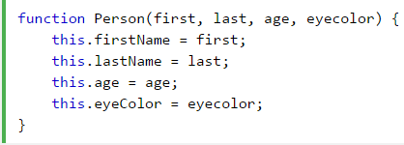

Create Prototype
Create prototype using constructor function
Create new objects from same prototype

Slide 59
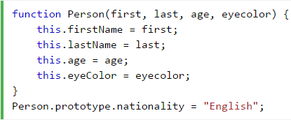
Using prototype Property
Add new properties to existing prototype
All Person object will have this property

Slide 60
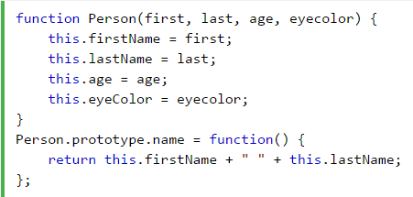
Using prototype Property
Add new methods to existing prototype
All Person object will have this method

Slide 61
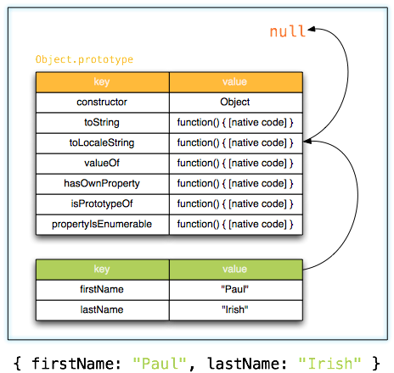
Why prototype?
Object properties lookup chain:
Notes:
New slide

Slide 62
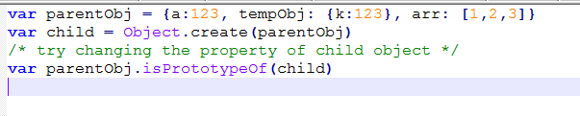
Why prototype?
Try prototype example
Notes:
New slide

Slide 63
DOCUMENT OBJECT MODEL

Slide 64
What is the browser ?
A web browser (commonly referred to as a browser) is a software application for accessing information on the World Wide Web.

Slide 65
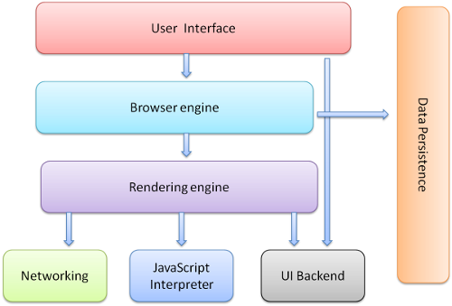
Browser components
Notes:
https://viblo.asia/p/browser-lam-viec-nhu-the-nao-3Q75wWWM5Wb

Slide 66
Different browsers use different rendering engines:
Internet Explorer uses Trident,
Firefox uses Gecko,
Safari uses WebKit.
Chrome and Opera use Blink, a fork of WebKit.

Slide 67
HTML DOM
The HTML DOM is a standard object model and programming interface for HTML.
It defines:
The HTML elements as objects
The properties of all HTML elements
The methods to access all HTML elements
The events for all HTML elements
The HTML DOM is a standard for how to get, change, add, or delete HTML elements.

Slide 68
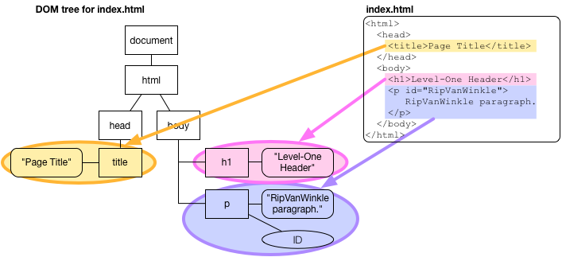
The HTML DOM Tree of Objects

Slide 69
DOM document (Document Object Model)
According to the W3C HTML DOM standard, everything in HTML document is a node:
The document itself is a document node
All HTML elements are element nodes
All HTML attributes are attribute nodes
Text inside HTML elements are text nodes
Comments are comment nodes
Notes:
Html element consist of start tag end tag

Slide 70
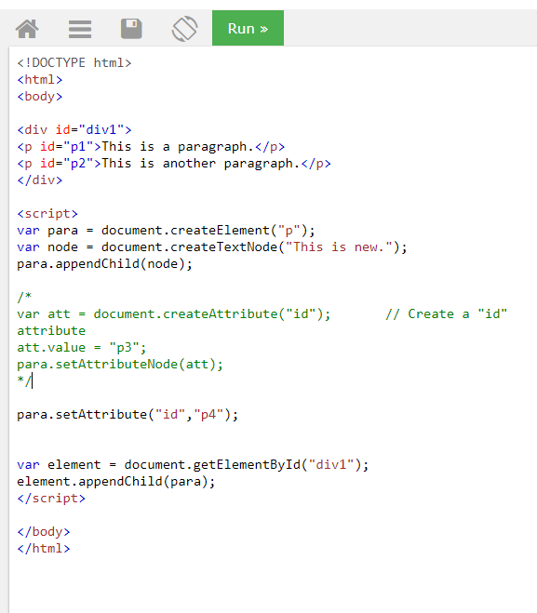
DOM nodes
A html node contains html element which can contains text node or attribute nodes. Sample flow to add new node
https://www.w3schools.com/code/tryit.asp?filename=FRY5TPE2C02P
Notes:
Html element consist of start tag end tag

Slide 71
Dom Events
Events are normally used in combination with functions, and the function will not be executed before the event occurs (such as when a user clicks a button).
<button onclick="myFunction()">Click me</button>
<script>
function myFunction() {
document.getElementById("demo").innerHTML = "Hello World";
}
</script>
Notes:
https://www.w3schools.com/js/js_htmldom_events.asp
function clickMeEvent(obj) {
if (obj.innerHTML == "Click Me") {
obj.innerHTML = "Click Me<br>Click Me Again";
return;
}
if (obj.innerHTML == "Click Me<br>Click Me Again") {
obj.innerHTML = "Thank You";
return;
}
if (obj.innerHTML == "Thank You") {
obj.innerHTML = "Goodbye";
return;
}
if (obj.innerHTML == "Goodbye") {
obj.style.display = "none";
return;
}
}

Slide 72
Changing HTML
document.getElementById("p1").innerHTML = "New text!";
document.getElementById(id).attribute = new value
var element = document.getElementById("id01"); element.innerHTML = "New Heading";

Slide 73
Navigations
parentNode
childNodes[nodenumber]
firstChild
lastChild
nextSibling
previousSibling
var firstChild = document.getElementById("id01").firstChild;
Notes:
https://www.w3schools.com/js/js_htmldom_navigation.asp
Example ExampleJavaScriptBrowser https://www.w3schools.com/jsref/tryit.asp?filename=tryjsref_nav_all
Parent only have accessed to firstChild and lastChild directly,
Siblings have link to other siblings
To loop through all child nodes, we use childNodes property
https://www.w3schools.com/jsref/tryit.asp?filename=tryjsref_node_childnodes

Slide 74
BROWSER OBJECT MODEL

Slide 75
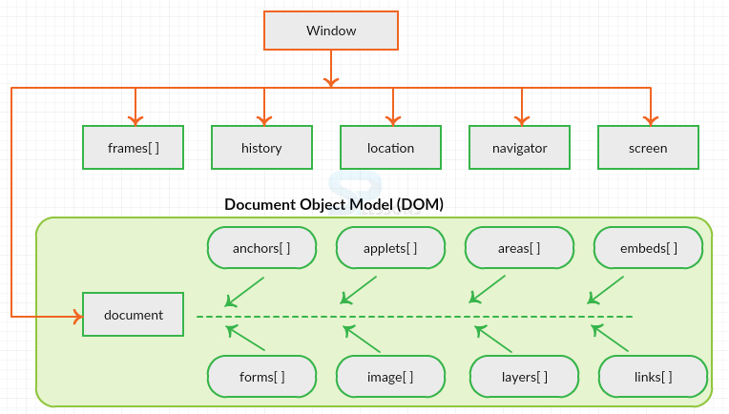
Browser object document (BOM)
BOM allows users manipulate the browser window without affecting the content of DOM
JS BOM can be visualized as shown
Notes:
There are no official standards for the Browser Object Model (BOM).
Since modern browsers have implemented (almost) the same methods and properties for JavaScript interactivity, it is often referred to, as methods and properties of the BOM
http://www.splessons.com/lesson/javascript-bom/
https://www.w3schools.com/jsref/coll_doc_embeds.asp

Slide 76
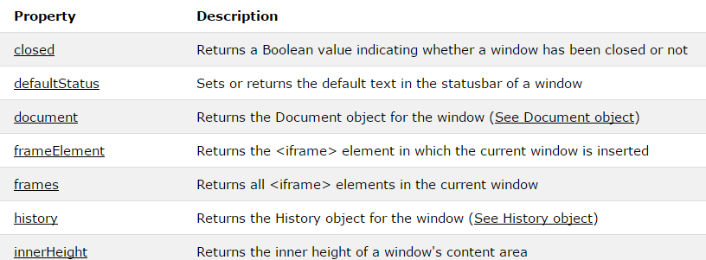
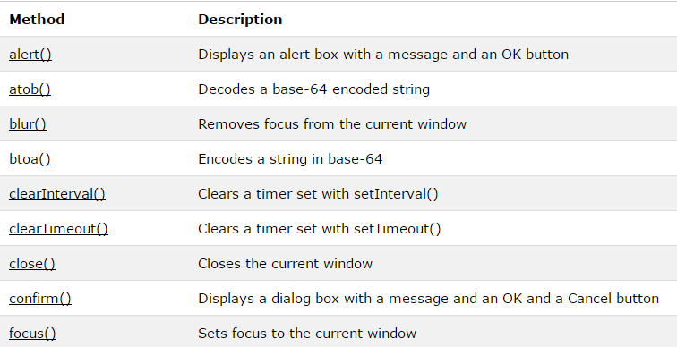
Window Objects
The window object represents an open window in a browser.
Notes:
https://www.w3schools.com/jsref/obj_window.asp
If a document contain frames (<iframe> tags), the browser creates one window object for the HTML document, and one additional window object for each frame.

Slide 77
Window Objects
JavaScript has three kind of popup boxes: Alert box, Confirm box, and Prompt box..
alert("I am an alert box!");
if (confirm("Press a button!") == true) { txt = "You pressed OK!"; } else { txt = "You pressed Cancel!"; }
window.prompt("sometext","defaultText");

Slide 78
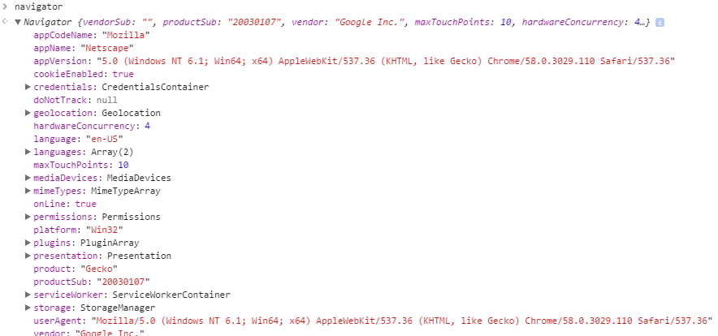
Navigator
Notes:
https://www.w3schools.com/jsref/tryit.asp?filename=tryjsref_nav_all

Slide 79
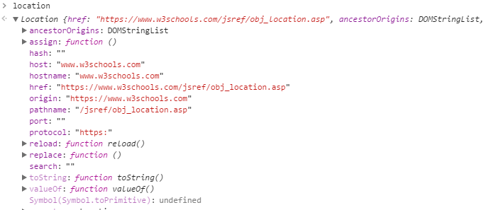
Location

Slide 80
Cookie
Cookies are data, stored in small text files, on your computer.
Cookies were invented to solve the problem "how to remember information about the user“
When a user visits a web page, his name can be stored in a cookie
Next time the user visits the page, the cookie "remembers" his name.
var x = document.cookie;
Notes:
Check out the example ExampleJavaScriptCookie with firefox

Slide 81
Web storage
window.localStorage - stores data with no expiration date
window.sessionStorage - stores data for one session (data is lost when the browser tab is closed)
Cookies are primarily for server-side reading (can also be read on client-side)
localStorage and sessionStorage can only be read on client-side.
Notes:
With local storage, web applications can store data locally within the user's browser.
Before HTML5, application data had to be stored in cookies, included in every server request. Local storage is more secure, and large amounts of data can be stored locally, without affecting website performance.
Unlike cookies, the storage limit is far larger (at least 5MB) and information is never transferred to the server.
Local storage is per origin (per domain and protocol). All pages, from one origin, can store and access the same data.

Slide 82
Examples
https://www.w3schools.com/js/js_window.asp

Slide 83
AJAX

Slide 84
Problem with traditional web?
In traditional web, to get information from server:
Make html form
GET or POST data to the server (like Submit button)
The browser loads a result page.
Traditional web app run slowly and tend to be less user friendly.

Slide 85

Why Ajax come in?
AJAX = Asynchronous JavaScript and XML
Update a web page without reloading the page
Request data from a server - after the page has loaded
Receive data from a server - after the page has loaded
Send data to a server - in the background
Notes:
http://www.w3schools.com/ajax/default.asp

Slide 86
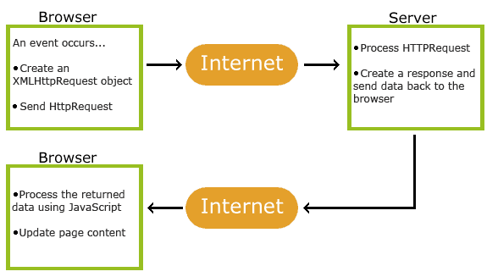
How Ajax works?
Notes:
http://blog.cloudfour.com/2011/09/

Slide 87
XMLHttpRequest Object
The keystone of AJAX is the XMLHttpRequest object.
All modern browsers support the XMLHttpRequest object.
The XMLHttpRequest object can be used to exchange data with a web server behind the scenes. This means that it is possible to update parts of a web page, without reloading the whole page.
Notes:
http://blog.cloudfour.com/2011/09/

Slide 88
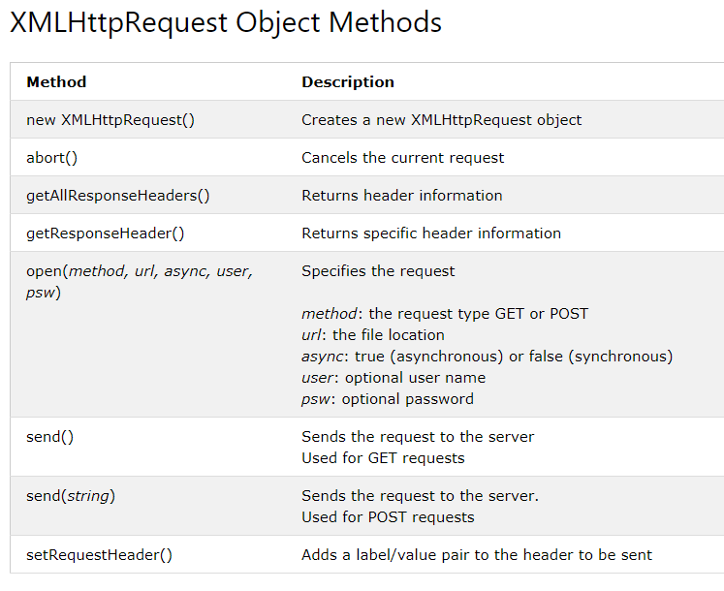
XMLHttpRequest Object
Notes:
http://blog.cloudfour.com/2011/09/

Slide 89
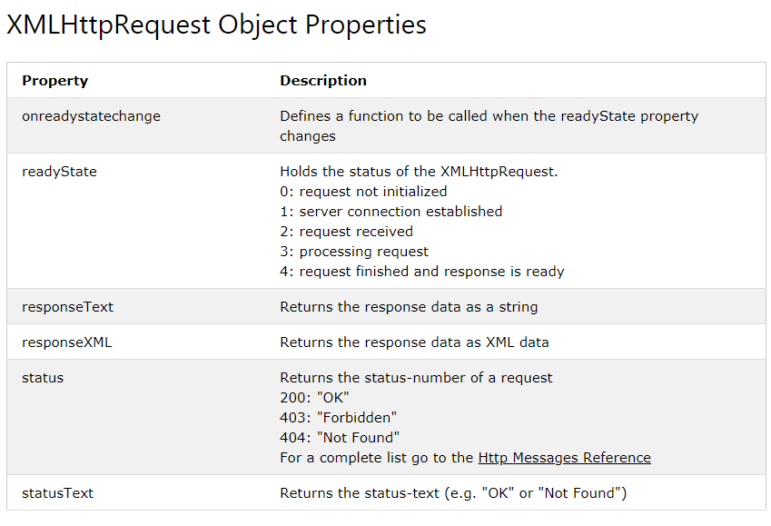
XMLHttpRequest Object
Notes:
http://blog.cloudfour.com/2011/09/

Slide 90

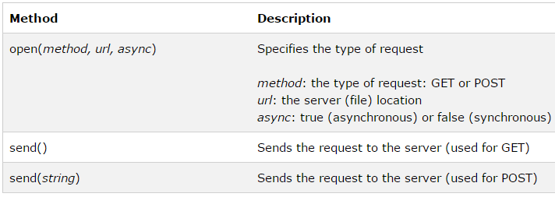
Ajax – send request
Create XmlHttpRequest object
Send request to server
Notes:
Dynamically Modify And Enhance Images By Changing Their URL
URL parameters: http://www.cdnconnect.com/docs/image-api/image-resizing
http://www.cdnconnect.com/docs/foresightjs
Picturefill: http://scottjehl.github.io/picturefill/
http://www.w3.org/community/respimg/wiki/Main_Page

Slide 91


Ajax – get or post ?
Get is simpler and faster than POST
Use POST when
Send large amount of data to server (no size limit)
Sending user input (robust and secure than GET)
Notes:
xhttp.open("GET", "ajax_info.txt", false); xhttp.send(); document.getElementById("demo").innerHTML = xhttp.responseText;

Slide 92
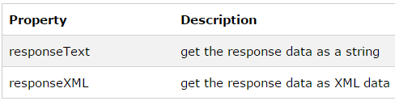
Ajax – server response
Use responseText or responseXML property of XMLHttpRequest object.
Notes:
http://www.sencha.com
Sencha creates development frameworks and tools that help you design, develop, deploy applications for desktop and mobile devices. Our goal is to enhance your development experience and final results by providing well-structured, Web standards-based frameworks and tools that make drafting functional UI and CSS3 animations a breeze, and cloud services for supporting your application available anytime, anywhere.
Sencha.io Src : Optimized Fast Image Delivery Sencha.io Src sizes your images to the device that is requesting them, then caches and optimizes them for efficient repeat delivery. Retina Display? Super-AMOLED? WVGA? XVGA? No problem. Now, there’s no need to serve a lowest common denominator image to everyone. With Sencha.io Src don’t worry about scaling your image assets for the variety of mobile screens. Put a single high resolution image on your server, point your IMG tag to Src and let the cloud take care of the rest. Sencha.io Sync: Seamless Mobile Synching Sencha.io Sync is a multi-master cloud based synchronization service built for the HTML5 web. With powerful persistence capabilities, even if your mobile replica is lost, Sencha.io Sync can sync a full application data set back to where it was last, leaving your customers comfortable saving their critical data with your app.
Sencha.io Src API
The API for Sencha.io Src is very simple. Provide the URL of a large image, and Src dynamically shrinks it down. Simply provide the address of the image, indicate how you want the image to display, and Src will do the rest. http://src.sencha.io/http://www.myapp.com/myimg.jpg﻿

Slide 93
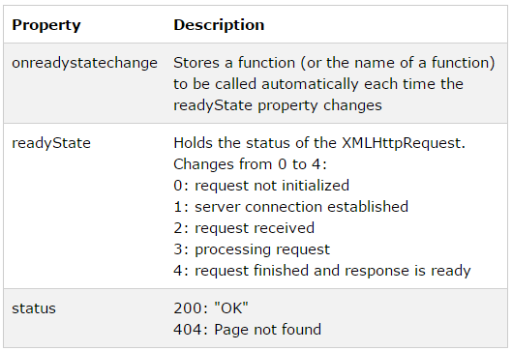
Ajax – event & callback
When a request to server is sent, perform some actions based on the response.

Slide 94

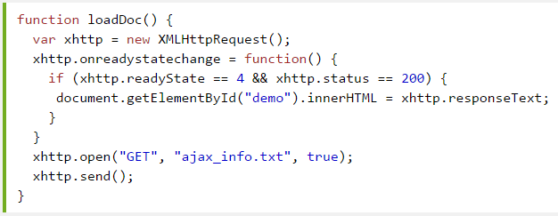
Ajax – example
Notes:
xhttp.open("GET", "ajax_info.txt", false); xhttp.send(); document.getElementById("demo").innerHTML = xhttp.responseText;

Slide 95
Javascript & AJAX example
Demo and do exercises

Slide 96
JSON

Slide 97
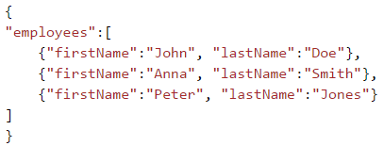
JSON
JavaScript Object Notation
Is lightweight data interchange format
The file type for JSON files is ".json"
The MIME type for JSON text is "application/json"

Slide 98
JSON
//Storing data: myObj = { "name":"John", "age":31, "city":"New York" }; myJSON = JSON.stringify(myObj); localStorage.setItem("testJSON", myJSON); //Retrieving data: text = localStorage.getItem("testJSON"); obj = JSON.parse(text); document.getElementById("demo").innerHTML = obj.name;

Slide 99
JSON vs XML
Both JSON and XML
Are self describing (human readable)
Are hierarchical (values within values)
Can be parsed and used by lots of programming languages
Can be fetched with an XMLHttpRequest

Slide 100
JSON vs XML
The difference
JSON doesn't use end tag
JSON is shorter
JSON is quicker to read and write
JSON can use arrays
XML has to be parsed with an XML parser. JSON can be parsed by a standard JavaScript function.

Slide 101
JSON – Data type
In JSON, values must be one of the following data types:
a string
a number
an object (JSON object)
an array
a boolean
null
Notes:
JSON values cannot be one of the following data types:
a function
a date
undefined

Slide 102
JSON
Demo and do exercises

Slide 103
Questions & Answer

Slide 104
Thank you!

Slide 105
Revision History
Date | Version | Description | Updated by | Reviewed and Approved By
Dec 01, 2015 | 1.0.0 | Change styles follow new CSC theme | Tri Phan
Jul 12, 2016 | 2.0.0 | Modified knowledge - add more basic js knowledge and remove advance information to better suit to Fresher level | Duyen Dang
Jun 07, 2017 | 3.0.0 | Remove jQuery and update more information for JS | Duyen Dang
Aug 2nd, 2017 | 4.0 | Retheme with DXC template |  | Quang Tran
Jun 3rd 2018 | 5.0 | Added details on JS and AJAX | Cuong Chau

